Slide 1

Using Word Study in Pre-K to Enhance Vocabulary, Concept Development, and Phonological Awareness
By Cathy Presson

Slide 2
What is Words their Way and Word Study?
Words Their Way is a developmental, research-based approach to vocabulary, phonics, and spelling instruction.
Why use Word Study in pre-k? Our students can’t even read yet!
    The hands-on word study approach motivates emergent learners and helps them acquire critical early literacy skills.
    Word study lets pre-k students begin to examine and categorize letters and sounds, as well as a child-centered approach to vocabulary growth.
(Johnston, F., Invernizzi, M., Helman, L., Bear, D.R., & Templeton, S., 2015)

Slide 3
In-Service Objectives
To understand what word study looks like and involves in pre-kindergarten classrooms
To understand how to support pre-kindergarteners in vocabulary, concept development, and phonological awareness skills by using word study
To understand how to design and implement word study activities with pre-k students

Slide 4
Using Word Study to Enhance Vocabulary and Concept Development
Why do vocabulary and concept development matter?
  Preschool is a time when vocabulary growth explodes and children come to school with “widely varying language experiences” (Bear, D. R., Invernizzi, M., Templeton, S., & Johnston, F., 2012).
  Research has shown that vocabulary and decoding skills are highly correlated, so much so that it has been speculated that higher oral language skills promote development of code-breaking practices. (Cabell, S.Q., Justice, L.M., Konold, T.R., & McGinty, A.S. (2010).
  Children from low-income homes begin kindergarten with a word exposure approximately 30 MILLION LESS than their peers from professional homes (Morrow & Gambrell, 2011).

Slide 5
Using Word Study to Enhance Vocabulary and Concept Development
What are some vocabulary developing practices you already use in the classroom?
  Intentional conversations
  Interactive read-alouds
  Dramatizing in centers or acting out definitions
Word Study Concept Sorts
  Help students develop new vocabulary meaning, as well as builds understanding of the relationship among similar and different objects
  Use pictures or real objects in the sorts
  Are a powerful extender of concepts introduced in books.

Slide 6
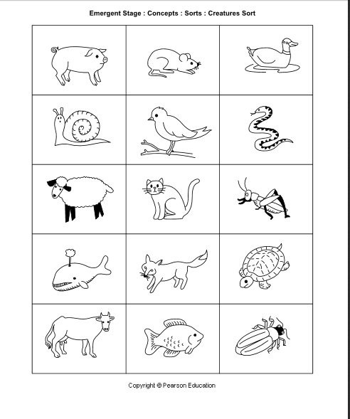
Let’s Give it a Try!
How would you sort it?
Land and water animals?
Six legs, four legs, two legs, no legs?
Farm, forest, and water animals?
Walks, flies, swims, slithers?
Take out the creature sort
What vocabulary and concepts could this help students understand?

Slide 7
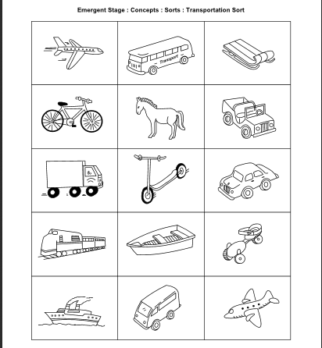
Let’s try one more:
What are some ways to sort these pictures?
What concepts could students learn?
What books or thematic concepts could you extend with this sort?

Slide 8
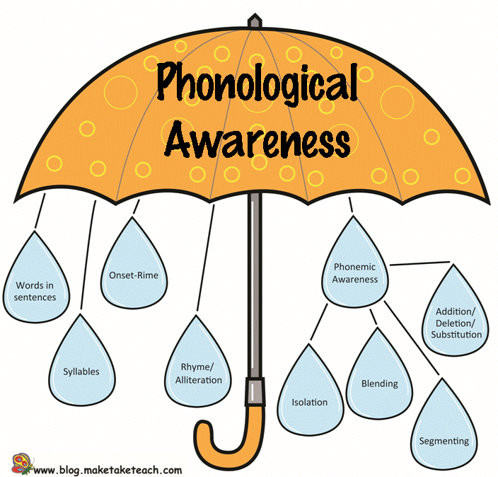
What is important to know about phonological awareness?
  Phonological awareness is crucial for future reading success, but each part does not need to be taught in isolation. The skills develop concurrently (Bear, Invernizzi, Templeton, & Johnston, 2011).

Slide 9
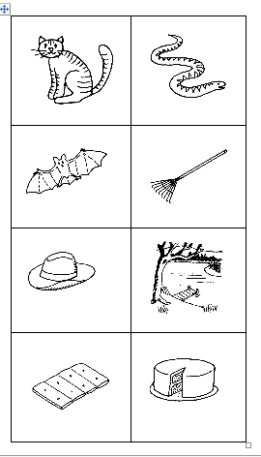
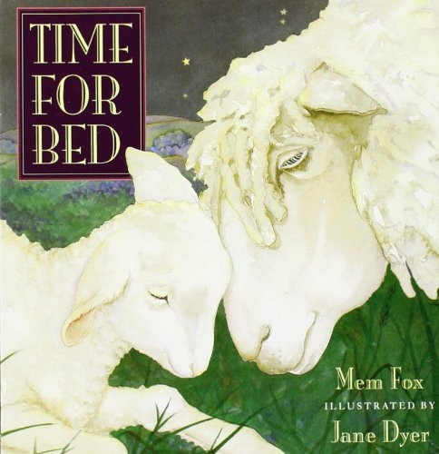
Using Word Study to enhance Phonological Awareness Skills
Rhyming
Begin with relevant connection to a book or thematic unit
Select two or three elements to use as base for a rhyme sort
The displayed sort was created using animals from the book:

Slide 10
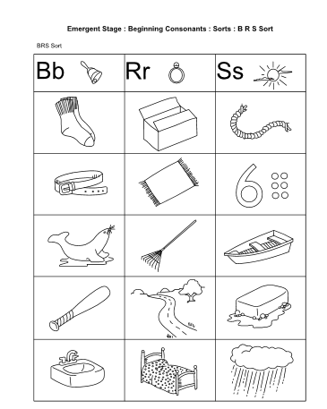
Using Word Study to enhance Phonological Awareness Skills
Beginning Sound Sorts
Are designed to focus student attention on the sounds in words.
Use your assessment data to plan effective beginning sound sorts. Children should be grouped according to similar understanding of alphabet letter sounds and familiar with at least one sound that included in the sort.

Slide 11
How to introduce a Beginning Sound Sort
Gather your materials.
Set the context for the sort by reviewing or reading a short book, poem or song.
Review the names of all pictures in the sort.
Demonstrate sorting the first few pictures and verbalizing WHY you are placing it in the designated column.
Sort WITH the child and model how to check for accuracy
Repeat sort.
Extend over several days to increase student familiarity and confidence.

Slide 12
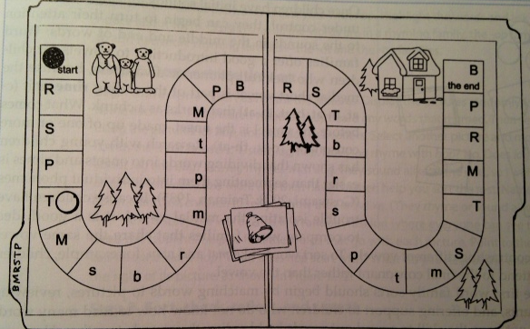
Extending Beginning Sound Sorts Across the Week
Monday Introduce the sort in a group. | Tuesday Repeat the sort as a group. Have children repeat either alone or with a partner and check their results. | Wednesday Repeat the sort in a center. As a group, brainstorm other words beginning with highlighted sort sounds. | Thursday Sort pictures again and play games using the sounds. | Friday Play games with the beginning sounds and re-sort or paste into a book.
Sample of a game where students draw a card, identify the beginning sound, and move to a spot that shows the symbol for the sound.

Slide 13
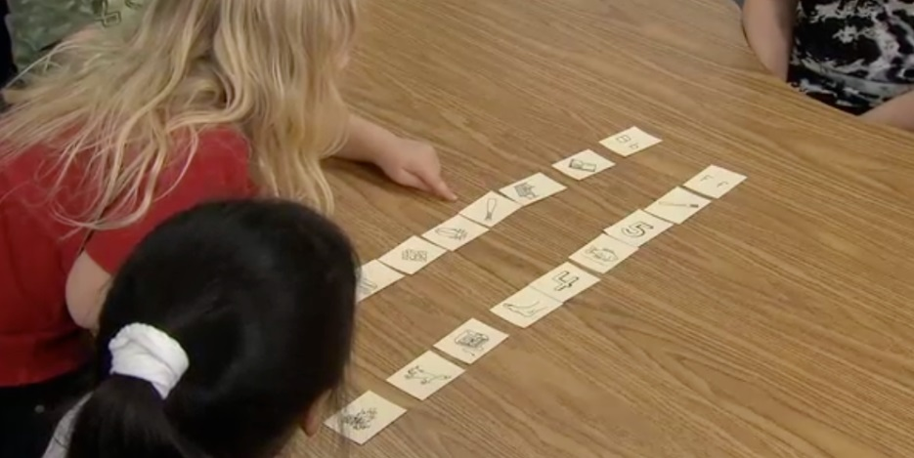
Tips for Sound Sort Success
Begin with sounds that have obvious contrasts and avoid those that begin at the same place of articulation. Sounds that can be elongated, such as m, s, and r are good to start with.
Use pictures that are easy to identify and sort. Avoid consonant blends, digraphs, and two-syllable words.
Correct initial mistakes, but let some remain so that the child can identify the picture that is placed incorrectly by himself when “reading” and checking each row.
Offer plenty of time during the week for follow-up practice, games, and activities.

Slide 14
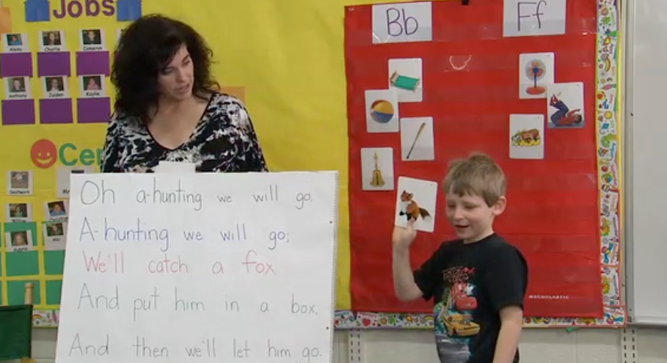
The Larger Picture
Word Study is a fun, easily-differentiated way to support young learners in many areas. In pre-k, it is critical to use word study in conjunction with many other high quality, developmental appropriate activities centered around early literacy. A sample week might include:
  Quality read-alouds
  Organized and thematic centers that promote literacy
  Quality and intentional conversations using new vocabulary
  Repeated readings of big books and pocket chart poems to promote concepts of print and word.

Slide 15


Thoughts or Questions?
Thanks for coming!!!

Slide 16
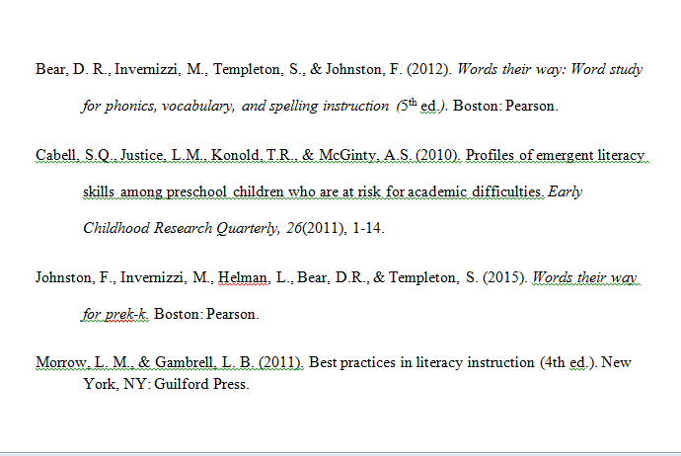
References:

